Slide 1
A Deep Learning Based Approach for Name Entity Recognition on Commercial Receipts
Spencer Han
MProfStuds Data Science, Sebastian Link

Slide 2

Outline
Motivation
Research Problem
Literature Review
Methodology
Findings so far
Plan to completion

Slide 3
Motivation
Extracting entity information from invoice data plays a fundamental role in automated transaction management and expense analytics. (Fraedom Ltd.)
Mature Optical Character Recognition (OCR) technology enables the transformation from image data to text data.
Now, an opportunity for Named Entity Recognition (NER).
Deep leaning based approaches have proven to be powerful in learning complex features from natural language data [1,2,3,4].

Slide 4
Research Problem
Can deep learning models be used to identify named entities from OCR’ed invoice data.
How well a state-of-art deep learning model deals with unstructured text data.
How well a state-of-art deep learning model copes with OCR noises.
Evaluation comparison among three model architectures.

Slide 5
Literature Review
NER with Bi-directional Long short-term memory + conditional random field (BiLSTM + CRF, 2015)[5]
NER with Bi-directional Long short-term memory + Convolutional Neural Network + Conditional Random Field (BiLSTM + CNN + CRF, 2018) [6]
NER with Deep contextualized word representations (ELMo) + BiLSTM, 2019) [7]
Biomedical named entity recognition using deep neural networks with contextual information (Cho, H. and Lee, H., 2019) [8]

Slide 6
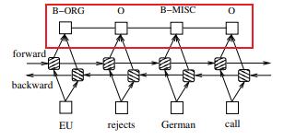
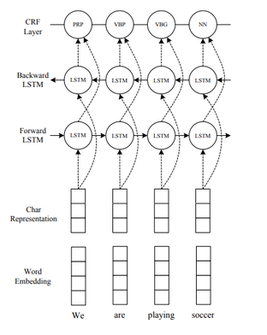
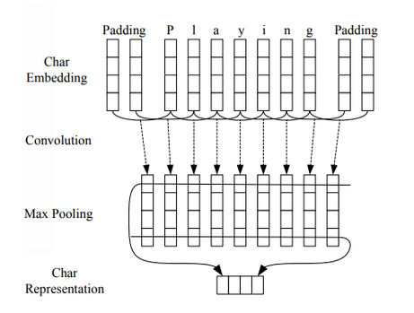
Model architecture I
BiLSTM - CRF
BiLSTM – CNN- CRF

Slide 7
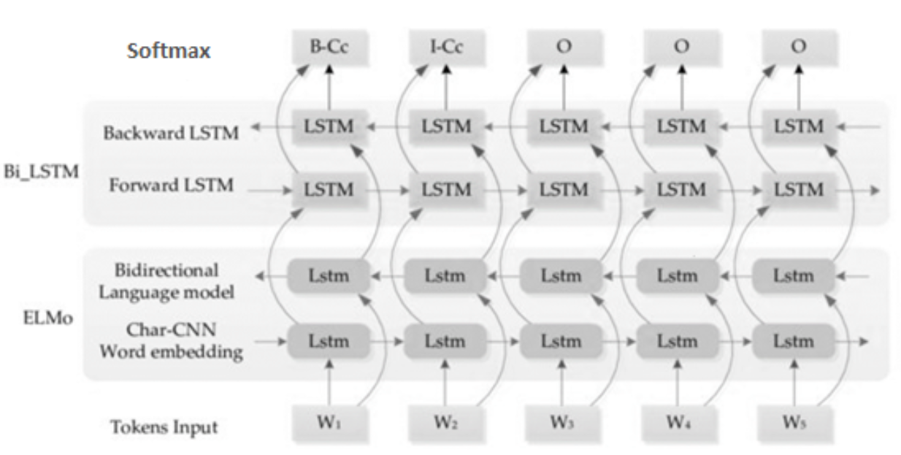
Model architecture II
ELMo - BiLSTM

Slide 8
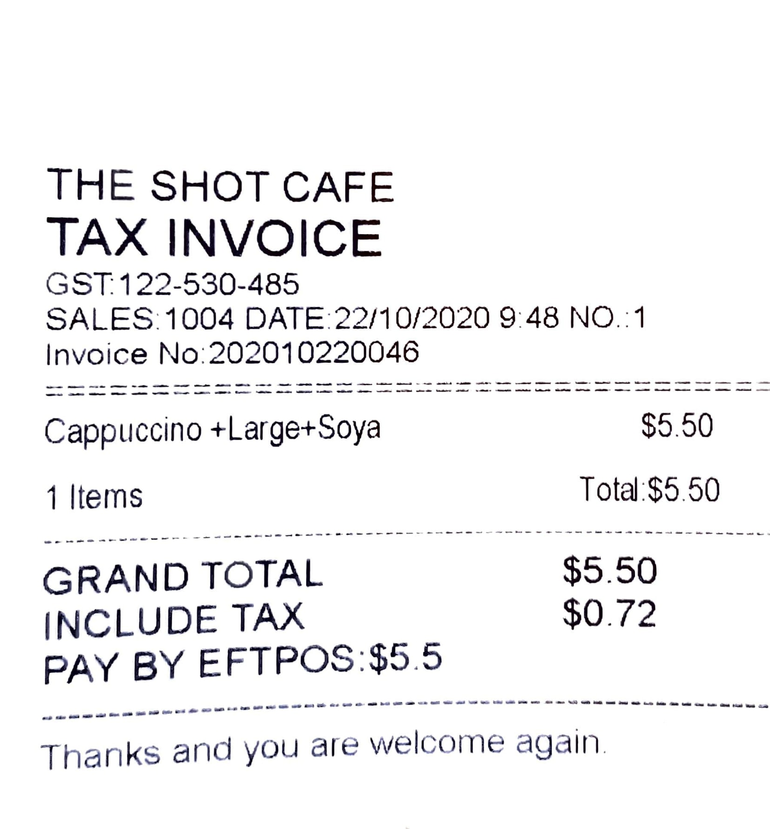
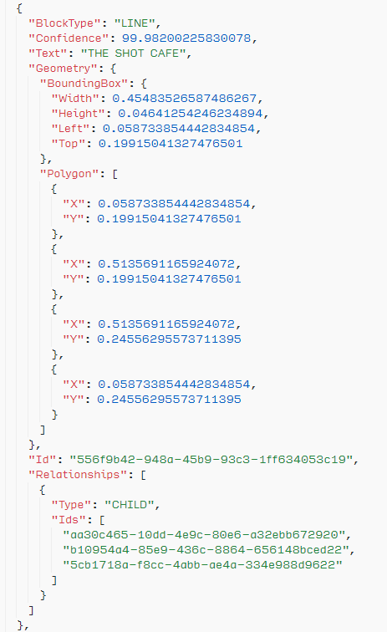
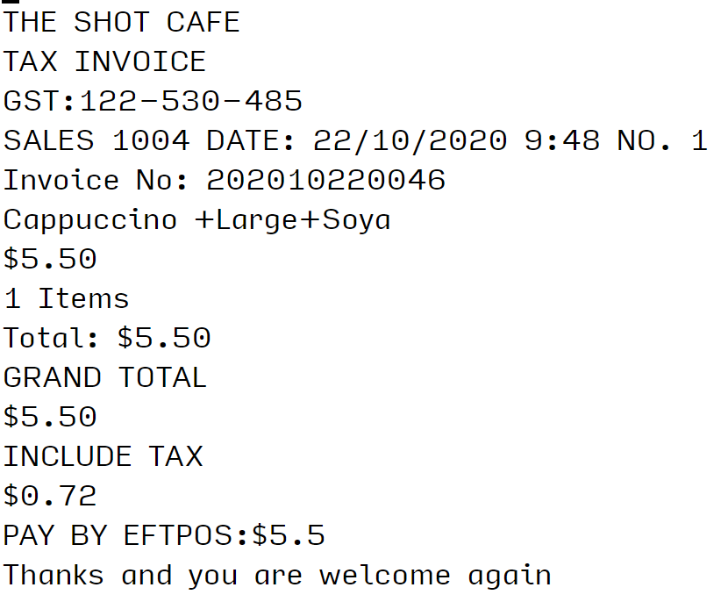
Methodology (*data)
* Invoice image to text (Amazon Textract)

Slide 9
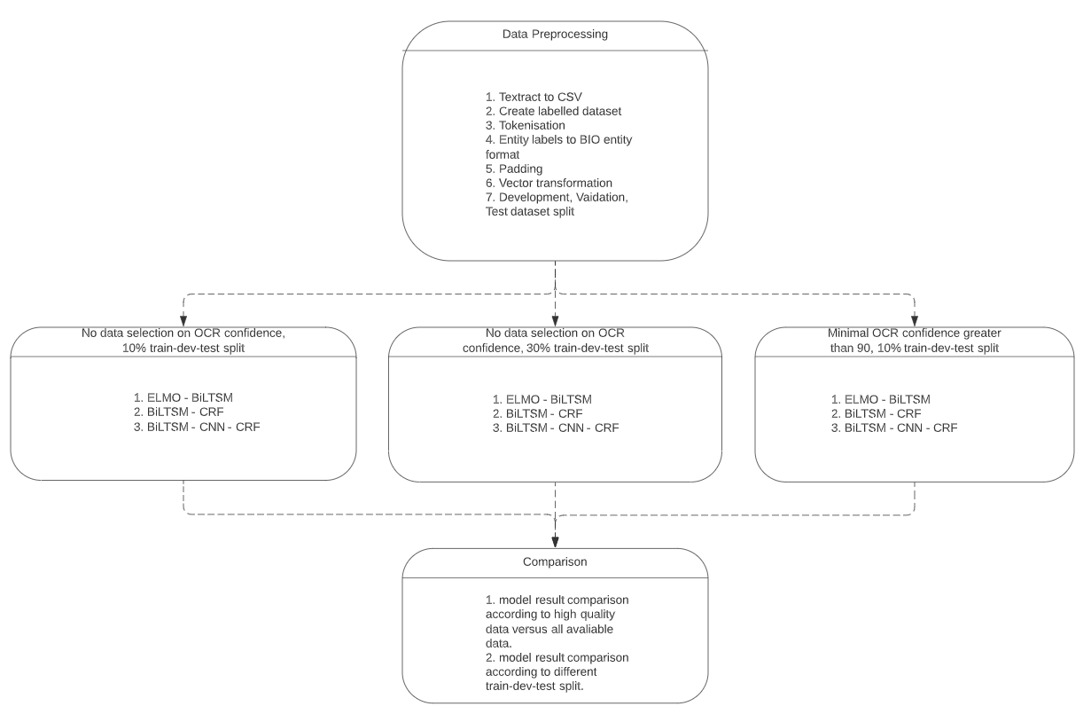
Methodology
Supervised learning approach
Data pre-processing
(1300 records, contain noises, 1150 records, high OCR confidence score)
Model training
Model evaluation
(Precision, recall, f1-score, different data structure)

Slide 10
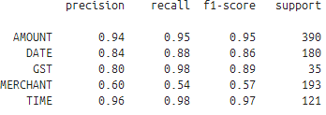
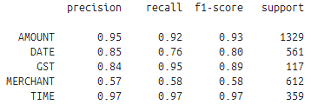
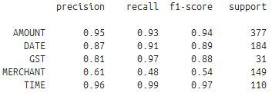
Finding so-far
ELMo – LSTM performs the best
Predictability against the merchant entity is the worst.
A hybrid NER system
Perfect training data and Hyperparameter tuning.
10% split 30% split 10% with confidence score > 90

Slide 11
Plan to completion
Evaluation matrices / per document.
Dissertation writing.

Slide 12
References
Deng, Li and Liu, Yang ‘A Joint Introduction to Natural Language Processing and to Deep Learning’, Deep Learning in Natural Language Processing. Springer Nature Singapore Pte Ltd, ISBN 978-981-10-5208-8, 2018, pp. 1-7.
Zaghloul, W., and Trimi, S., ‘Developing an innovative entity extraction method for unstructured data’, International Journal of Quality Innovation, 2017, 3. 10.1186/s40887-017-0012-y.
Yang, J., Liu, Y., Qian, M., Guan, C. and Yuan, X. ‘Information Extraction from Electronic Medical Records Using Multitask Recurrent Neural Network with Contextual Word Embedding’. Appl. Sci. 2019, 9, 3658.
Li, J., Sun, A., Han, J., and Li, C., ‘A Survey on Deep Learning for Named Entity Recognition’, CoRR, 2018, abs/1812.09449
Huang, Z., Xu, W., and Yu, K., ‘Bidirectional LSTM-CRF Models for Sequence Tagging’, Computation and Language, 2015, arXiv:1508.01991
Ma, X. and Hovy, E., ‘End-to-end Sequence Labeling via Bi-directional LSTM-CNNs-CRF’, Computation and Language 2016, arXiv:1603.01354
Peters, M., Neumann, M., Iyyer, M., Gardner, M., Clark, C., Lee, K., and Zettlemoyer, L., ‘Deep Contextualized Word Representations’, Proceedings of the 2018 Conference of the North American Chapter of the Association for Computational Linguistics: Human Language Technologies, Volume 1 (Long Papers), Association for Computational Linguistics, 2018, 2227-2237
Cho, H., and Lee, H., ‘Biomedical named entity recognition using deep neural networks with contextual information’ BMC Bioinformatics, 2019, 20

